Slide 1

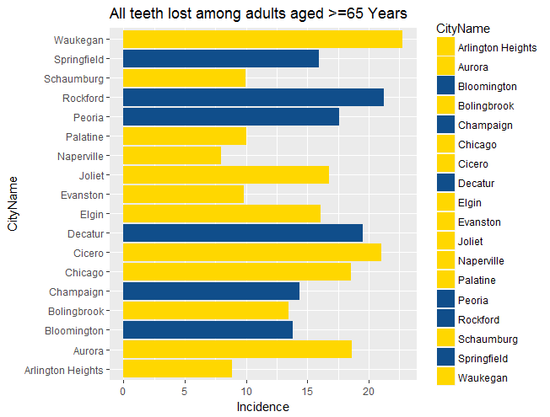
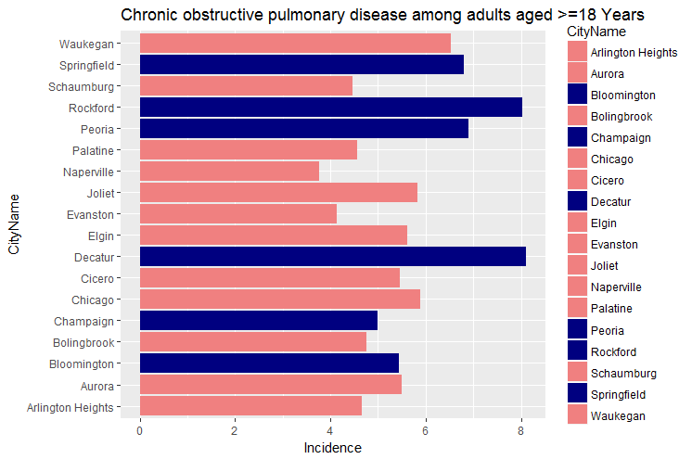
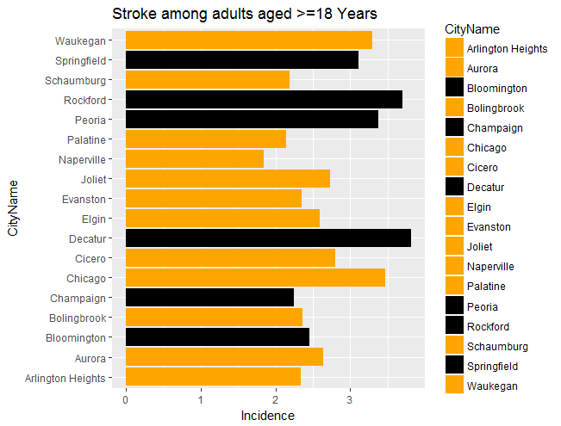
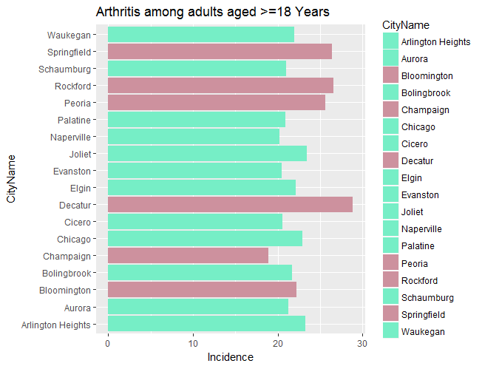
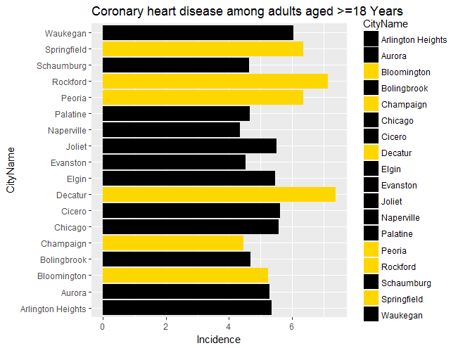
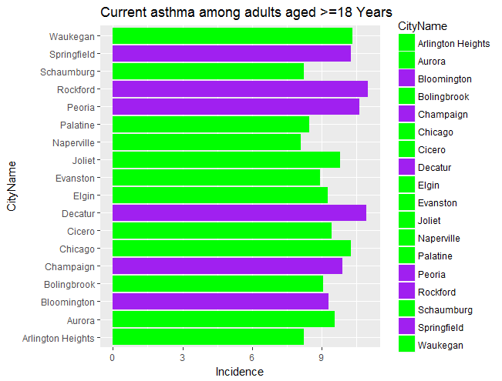
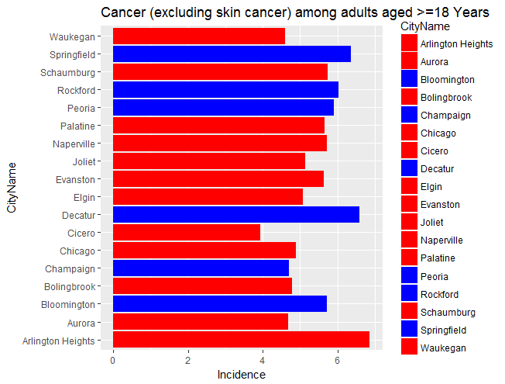
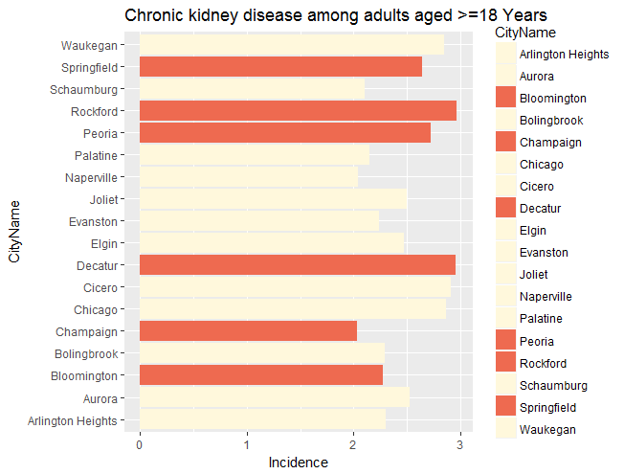
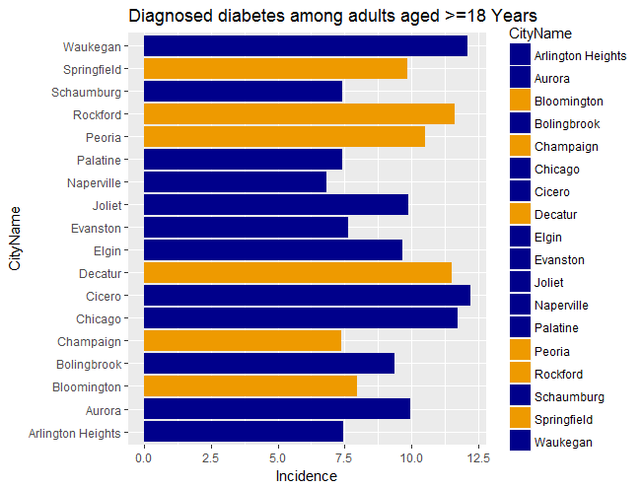
Intro To Data Science: Illinois Health Outcomes of Most Populated 18 Cities
Stacey Stevens and Samuel Duffield
St. Louis College of Pharmacy, St. Louis, Missouri
Project Overview
The goal of this project was to create a working database in the program RStudio from https://www.healthdata.gov/dataset/500-cities-local-data-better-health-0 and present results graphically to investigate possible correlations between negative chronic health outcomes in cities inside or outside of the Chicago metropolitan area.
Hypothesis
Negative chronic health outcomes are more common in the Chicago metropolitan area. Project Goals
To make a working database in RStudio by filtering cities in Illinois from the national data and selecting variables pertinent to our hypothesis.
To convert the data we filtered out from our source into graphs that represent our data and ease analysis with respect to our hypothesis.
To use the graphs and filtered data to determine if there is a possible correlation between chronic outcomes between cities in Illinois that are inside or outside of the Chicago metropolitan area that may merit further analysis.
Method
The first step we chose to do was to pick our topic from https://www.healthdata.gov/. The topic we chose was about 27 chronic outcomes from the top 500 cities in the United States found at https://www.healthdata.gov/dataset/500-cities-local-data-better-health-0. We were able to find their working data frame, and we used RStudio to explore the data.. We found more information from their home page at https://www.cdc.gov/500cities/ about the contents of the data frame.
The second step we chose to do was to go back and look at past homework assignments that involved filtering data in RStudio and then determined which variables we needed to filter out.
The third step was to filter out the variables we wanted to represent our data. We then had to write code to calculate a total population count and incidence rate for each city and health outcome. The variables we chose to represent our data were: Total population count, city name, incidence, state, category, and measure. We decided to narrow down our data frame to the cities in the state of Illinois, and concentrate on the category “Health Outcomes”.
The fourth step was to convert the filtered data and represent it in a graph that helped to visualize any correlations between health outcomes in cities inside or outside of the Chicago metropolitan area. These graphs were created using the RStudio cheat sheet, and they represented data that was pertinent to confirming or disproving our hypothesis.
We also used Excel to tabulate this data to help us draw conclusions about the results.
Results
The graphs to the right represent metropolitan and nonmetropolitan cities in different colors. They did not seem to support our initial hypothesis based on a cursory visual inspection. In order to quantize results, we used sorting functions in RStudio to tabulate top results in Excel as shown below.
Although individual health outcomes had various incidence percentages among individual cities, there was a clear increase in chronic negative health outcome rates among four of the cities outside of the Chicago metropolitan area.
Two other cities outside of the Chicago metropolitan area did not seem to follow the trend of the other four, and some metropolitan cities had relatively high incidence rates as percentages.
Conclusion
Our hypothesis was incorrect, and four of the six cities outside of the Chicago metropolitan area had the highest average rank for rates of negative health outcomes.
The other two cities outside of the Chicago metropolitan area did not follow this trend, and the differences between cities outside the Chicago metropolitan area may merit further investigation for factors that may influence this trend.
Incidence Rate Ranking for 18 cities in Illinois | All teeth lost among adults >= 65 | Arthritis among adults >= 18 | CKD in adult >= 18 | Cancer except skin cancer among adults >= 18 | CHD among adults >= 18 | Stroke among adults >= 18 | Asthma among adults >=18 | Diabetes among adults >=18 | COPD among adults >= 18 | Average Health Outcome Incidence Ranking
Decatur | 4 | 1 | 2 | 2 | 1 | 1 | 2 | 5 | 1 | 2.1
Rockford | 2 | 2 | 1 | 4 | 2 | 2 | 1 | 4 | 2 | 2.2
Peoria | 7 | 4 | 6 | 5 | 4 | 4 | 3 | 6 | 3 | 4.7
Springfield | 10 | 3 | 7 | 3 | 3 | 6 | 5 | 9 | 4 | 5.6
Waukegan | 1 | 10 | 5 | 17 | 5 | 5 | 4 | 2 | 5 | 6.0
Chicago | 6 | 7 | 4 | 13 | 7 | 3 | 6 | 3 | 6 | 6.1
Joliet | 8 | 5 | 9 | 11 | 8 | 8 | 8 | 8 | 7 | 8.0
Cicero | 3 | 15 | 3 | 18 | 6 | 7 | 10 | 1 | 10 | 8.1
Aurora | 5 | 12 | 8 | 16 | 11 | 9 | 9 | 7 | 9 | 9.6
Elgin | 9 | 9 | 10 | 12 | 9 | 10 | 12 | 10 | 8 | 9.9

